Slide 1

Car Accident Severity
COURSERA CAPSTON PROJECT

Slide 2
Background
An insurance company is looking to use regional data to determine region-specific insurance premiums for their latest risk pushing exercise.

Slide 3
Data Source
The data is provided by the course materials in a csv format.
There 37 attributes in the table with approximately 19,000 entries.

Slide 4
Target Feature
The target feature we are interested in is SEVERITYCODE, which directly correlates to the accident severity and hence the cost of the accident.

Slide 5
Features Chosen
We want to predict severity code with relevance to environmental parameters. The chosen parameters are as follows:

Slide 6

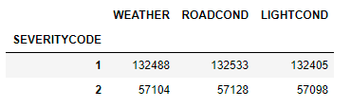
Cleaning the Data
We see that while SEVERITY CODE 1 and 2 has 136,485 and 58,188 entries, the corresponding features are less. This means that there are null values for our feature parameters.

Slide 7

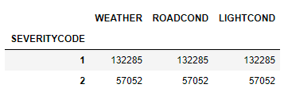
Cleaning the Data
After cleaning, the entry count matches and we see that SEVERITY CODE 1 and 2 has 132,285 and 57,052 entries.

Slide 8
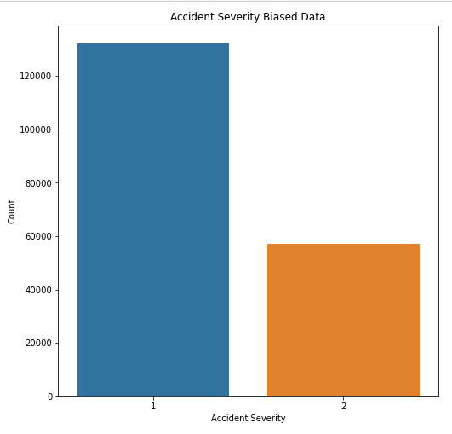
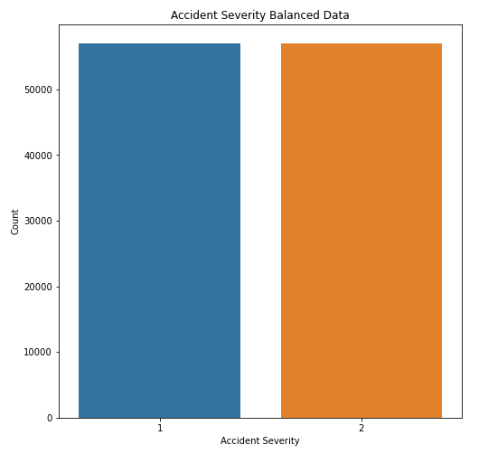
Balancing the Data
To resolve the biased data, we balance the data by undersampling.

Slide 9
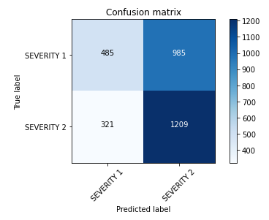


Three Classification Algorithms
SVM
Logistic Regression
Decision Tree

Slide 10
Using Metrics like F1 Score and Jaccard
Logistic Regression is the most accurate model

Slide 11
Conclusion
This model is able to determine the severity code based on environmental conditions.
Future data collection should include the actual cost of insurance payout for the accident for the model to directly correlate to regional insurance premium.

